Slide 2
What is Pets As Therapy?
Began in 1983 with a single German Shepherd dog
Now largest companion animal visiting service in Europe
Approximately 4,500 registered volunteers and PAT dogs
Just over 100 PAT cats
Supported by volunteers with their own friendly, temperament tested and vaccinated dogs and cats.
Watch the Video here: http://youtu.be/LwFjLeMuRSg

Slide 3
PAT is unique in that it provides therapeutic visits to:
hospitals
In day centres
Hospices
nursing and care homes
In special and mainstream schools (Read2Dogs)
Working with phobic patients
Working with stroke patients
Working with people suffering from clinical depression

Slide 4
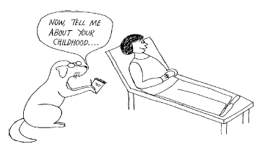
Becoming a volunteer team with Pets As Therapy
Any dog or cat can become a P.A.T. dog or a P.A.T. cat,
(as long as it has been with its owner for at least 6mths, is over 9mths of age and can pass the assessment)
Annual subscription
All P.A.T. dogs and cats wear a special ID disc on their collars. Their owners also wear a special ID badge whilst on visits
Pets As Therapy volunteers generously give their time. The amount of time varies, but regular visits are appreciated.

Slide 5
Animals can make us feel good!
• Reduce high blood pressure
• Reduce depressive symptoms
• Reduce physical and psychological stress
• Increase motivation and confidence
“Animals are such agreeable friends – they ask no questions, they pass no criticisms.” – George Eliot

Slide 6
How you can help Pets As Therapy
Apply to become a visiting team with your dog or cat.
Become a supporter. Dog shows, clubs and societies can become supporters.
Establishments can become supporters of the Charity, as well as receiving visits from P.A.T. dogs and cats
Send a donation to Pets As Therapy or make a small donation to Pets As Therapy.
Sponsor a volunteer

Slide 7
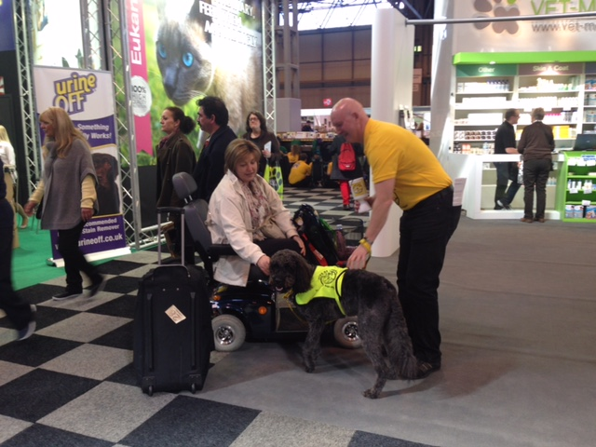
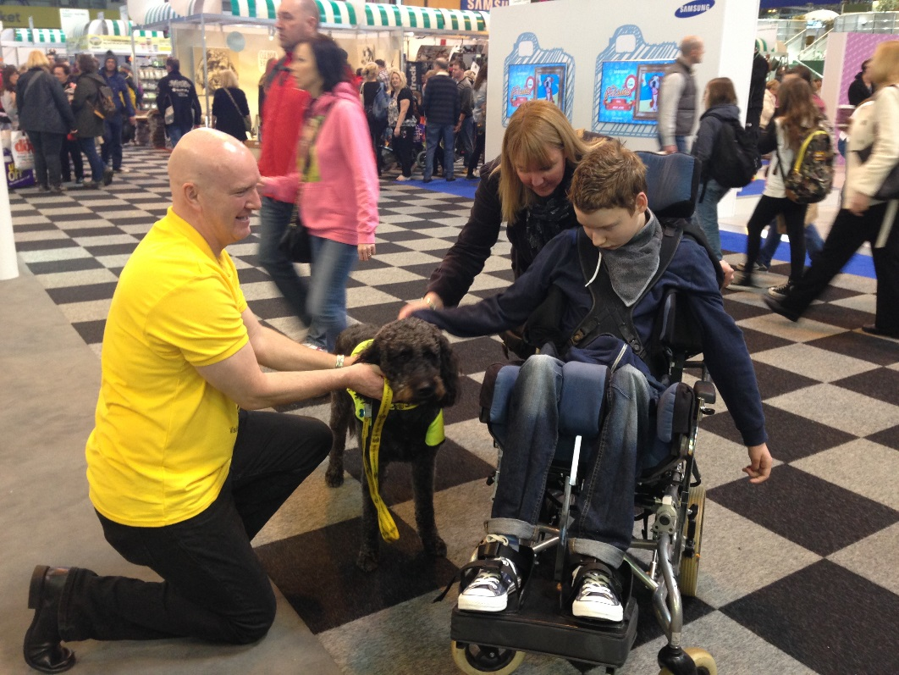
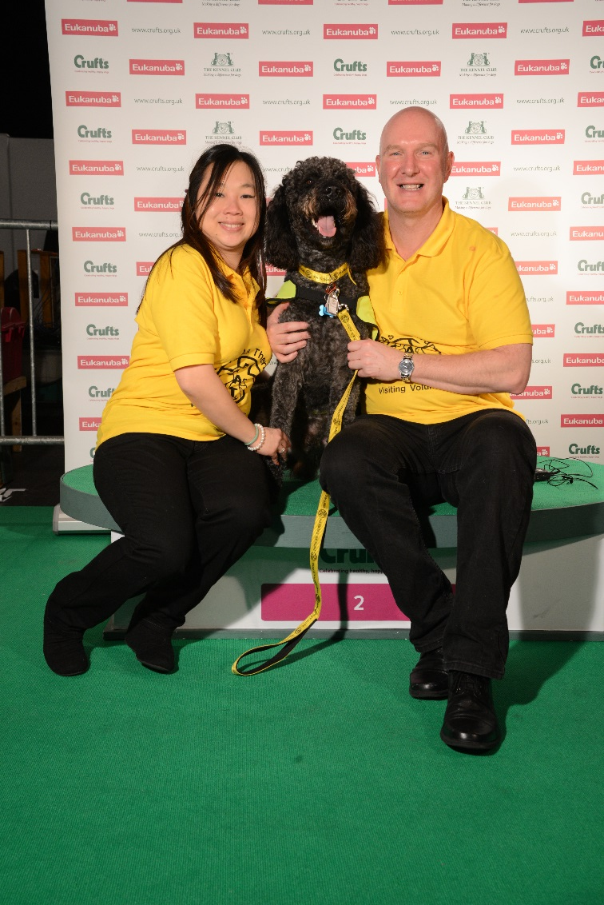
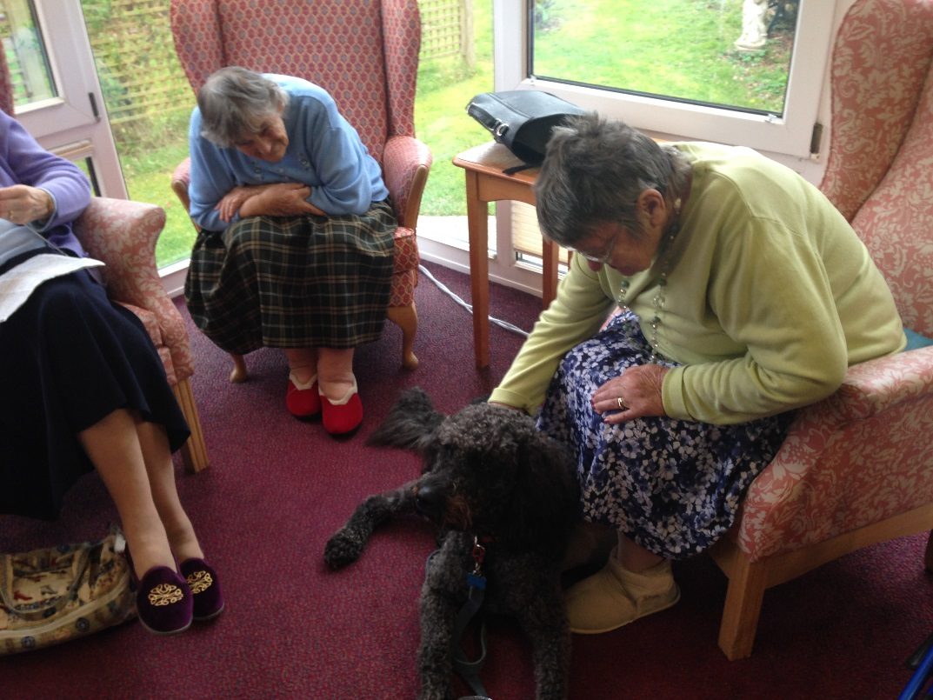
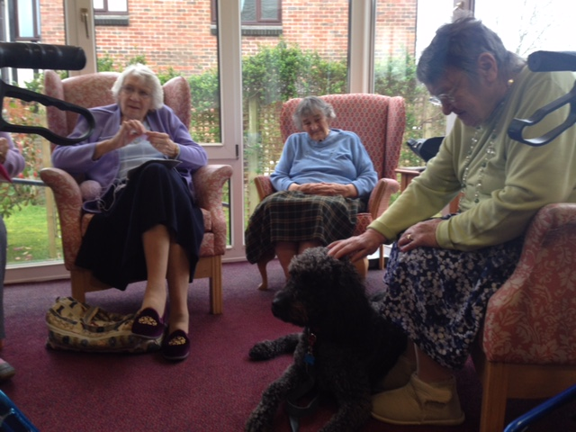
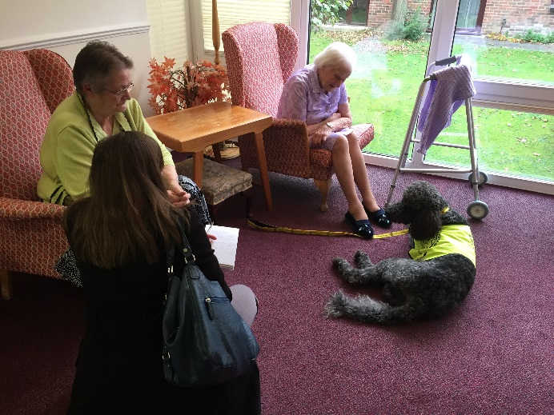
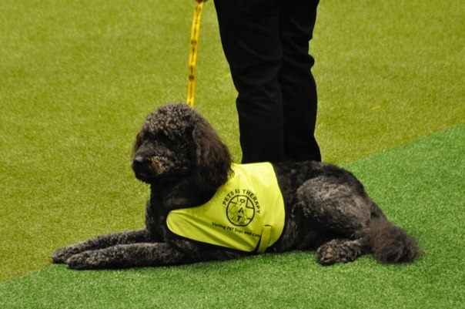
Watch Alfie at Crufts: https://www.youtube.com/watch?v=5yUXxzjWcjY

Slide 8
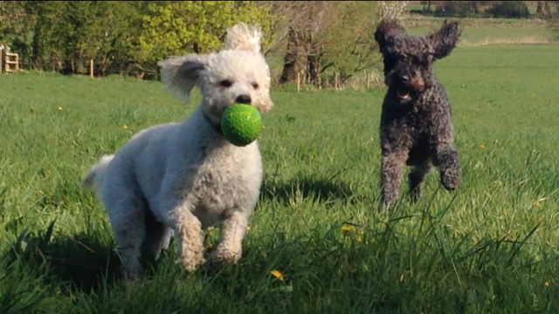
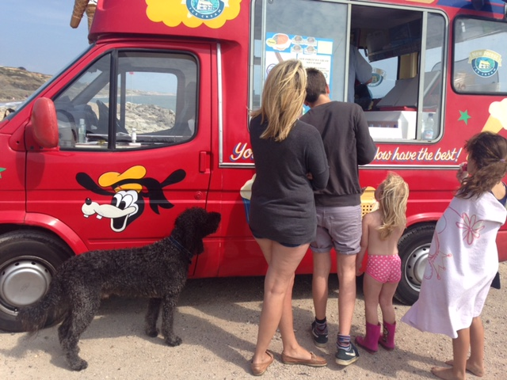
Alfie is a PAT dog but at the end of the day, he is still our very loved family pet.
A Little Dogs Prayer
A master who is firm and kind,
And understands a Doggie mind;
A “Walkie” and a meal each day.
That is all I ask for when I Pray

